Slide 1
Clinic Management System
Work Breakdown Structure & Timeline Presentation

Slide 2
Work Breakdown Structure (WBS)
1.1 - Define goals and scope (Initiation)
1.2 - Feasibility study and risk assessment (Initiation)
2.1 - Stakeholder analysis (Planning)
2.2 - Requirement gathering (Planning)
2.3 - Project charter & approval (Planning)
2.4 - Resource and budget planning (Planning)
3.1 - System architecture design (Design)
3.2 - UI/UX wireframes (Admin, Doctor, Patient) (Design)
3.3 - Database schema design (ERD) (Design)
4.1 - Backend API Development (.NET MVC + SQL) (Development)

Slide 3
Work Breakdown Structure (Cont'd)
4.2 - Frontend – Admin Dashboard (Razor/MVC) (Development)
4.3 - Frontend – Doctor Portal (Development)
4.4 - Frontend – Patient Portal (Booking) (Development)
4.5 - Role-based Authentication & Permissions (Development)
4.6 - Appointment Scheduling Module (Development)
4.7 - Billing & Invoice Module (Development)
4.8 - Notifications (Email/SMS) (Development)
5.1 - Unit testing (Testing)
5.2 - System integration testing (Testing)
5.3 - User Acceptance Testing (UAT) (Testing)
6.1 - Hosting & deployment setup (Deployment)
6.2 - Live environment go-live (Deployment)
7.1 - Admin & Staff Training (Training)
7.2 - Documentation delivery (Training)
8.1 - Bug fixes and updates (Maintenance)
8.2 - Support & feedback integration (Maintenance)

Slide 4
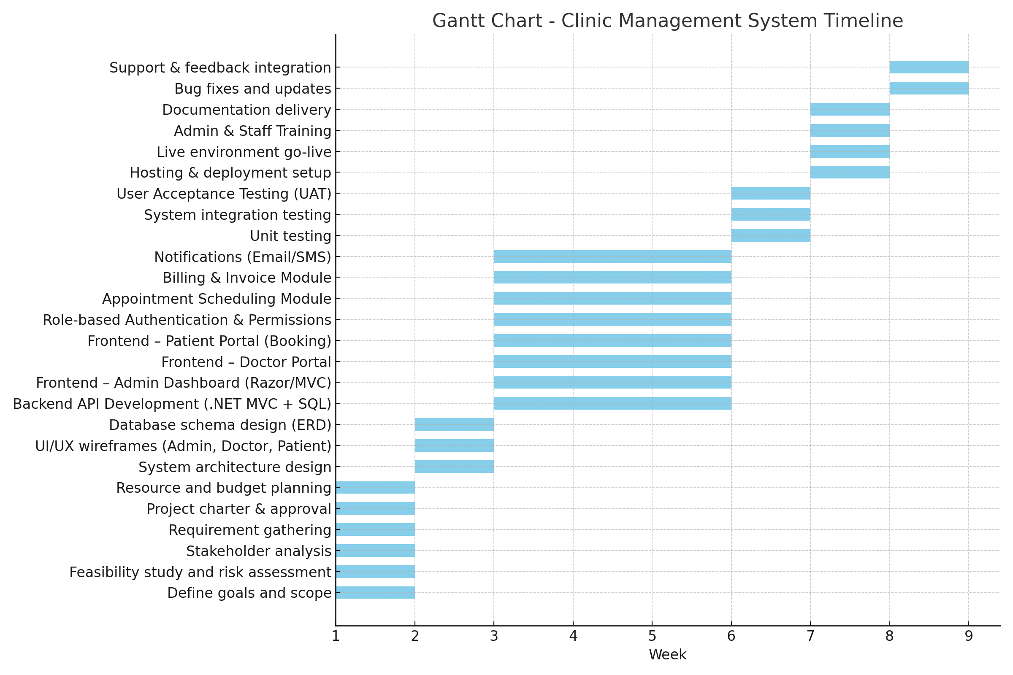
Gantt Chart Timeline

